Slide 1

6th Grade Accelerated Math
Unit 14, Lesson 9
Solving One-Step Inequalities Using Addition and Subtraction Volume 2, pg. 383

Slide 2


Benchmark
MA.7.AR.2.1
Write and solve one-step inequalities in one variable within a mathematical context and represent solutions algebraically or graphically.
volume 2, pg. 383

Slide 3
Integrated Mathematical Thinking and Reasoning Standards
MA.K12.MTR.1.1 Actively participate in effortful learning both individually and collectively.
MA.K12.MTR.2.1 Demonstrate understanding by representing problems in multiple ways.
MA.K12.MTR.4.1 Engage in discussions that reflect on the mathematical thinking of self and others.
MA.K12.MTR.6.1 Assess the reasonableness of solutions.
MA.K12.MTR.7.1 Apply mathematics to real-world contexts.
volume 2, pg. 383

Slide 4

Learning Targets
I can relate the solution set of an inequality to its graph on a number line.
I can relate the solution set of an inequality to the context it represents.
I can determine the minimum or maximum value that makes an inequality true.
I can solve one-step inequalities in one variable using addition or subtraction.
I can relate properties of inequality to solving one-step inequalities algebraically.
volume 2, pg. 383

Slide 5

Warm-Up
volume 2, pg. 384

Slide 6
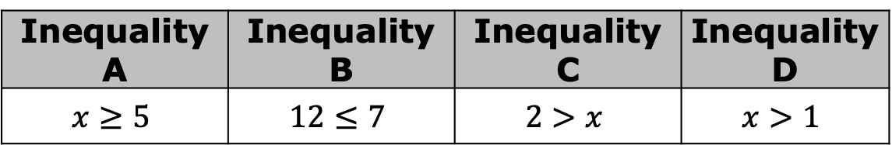
14.9.1 Warm-Up: Which One Doesn’t Belong?
Four inequalities are shown.
Javier says that Inequality B does not belong with the others. What is one reason Javier might have said this?
Select a different inequality and explain why it doesn’t belong.
Inequality A | Inequality B | Inequality C | Inequality D
$$x≥5$$ | $$12≤7$$ | $$2>x$$ | $$x>1$$
volume 2, pg. 384

Slide 7

Exploration
volume 2, pg. 384

Slide 8

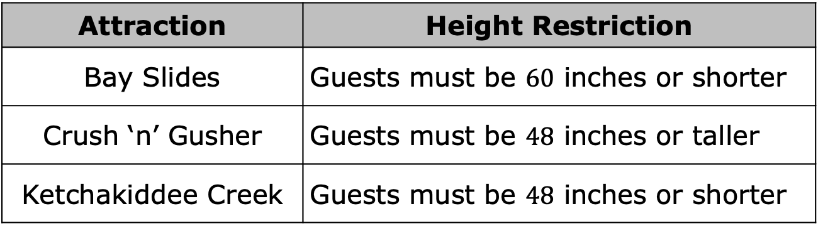
14.9.2 Exploration: Representing Inequalities in Context
Height restrictions are often in place for roller coasters and rides at amusement parks to keep guests safe. At Disney’s Typhoon Lagoon Water Park, the following height restrictions are in place.
Attraction | Height Restriction
Bay Slides | Guests must be $60$ inches or shorter
Crush ‘n’ Gusher | Guests must be $48$ inches or taller
Ketchakiddee Creek | Guests must be $48$ inches or shorter
volume 2, pg. 384

Slide 9
Work with your partner to determine which graph represents the height restrictions of each attraction at Typhoon Lagoon. Then, draw an arrow from each attraction to its matching graph.
Attraction
Bay Slides
Crush ‘n’ Gusher
Ketchakiddee Creek
Graph Representing Safe Heights for the Attraction
volume 2, pg. 384

Slide 10
Nick is happy to realize that he is tall enough to go on the Crush ‘n’ Gusher raft ride. Nick’s friend Matt is 2 inches shorter than Nick. Explain whether Matt is tall enough to go on the ride with Nick.
volume 2, pg. 385

Slide 11
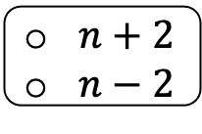

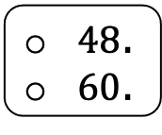
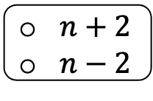
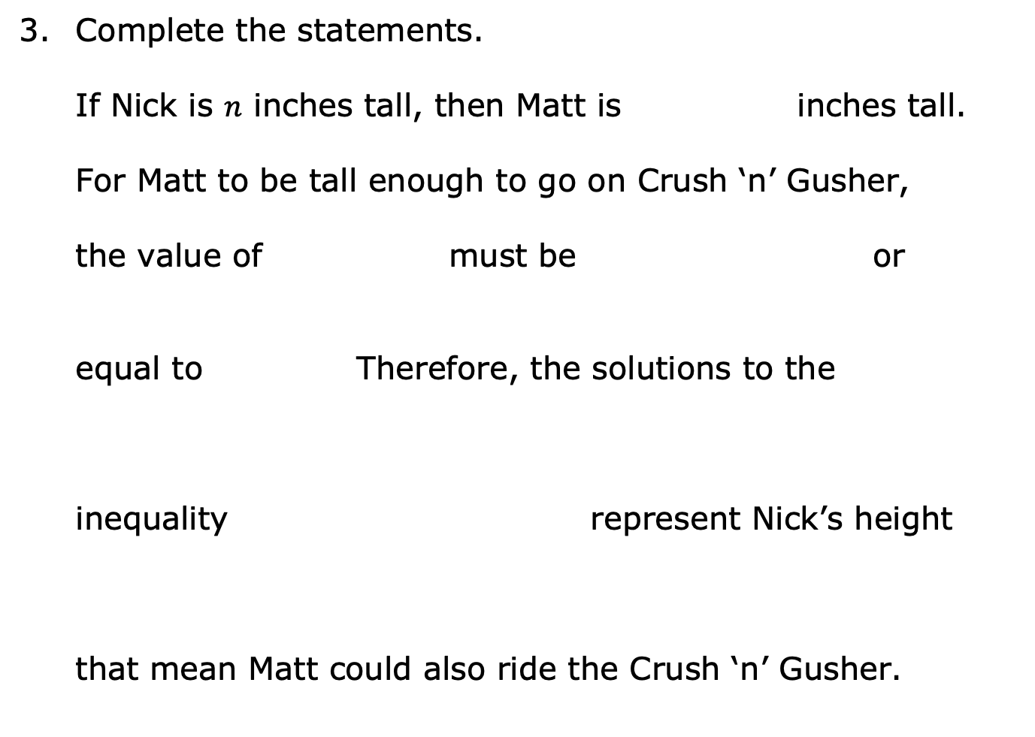
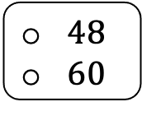
Complete the statements.
If Nick is $n$ inches tall, then Matt is inches tall.
For Matt to be tall enough to go on Crush ‘n’ Gusher,
the value of must be or
equal to Therefore, the solutions to the
inequality represent Nick’s height
that mean Matt could also ride the Crush ‘n’ Gusher.
$n+2$
$n−2$
$n+2$
$n−2$
less than
greater than
$48$.
$60$.
$n+2≤$
$n+2≥$
$n−2≤$
$n−2≥$
$48$
$60$
volume 2, pg. 385

Slide 12
On the number line, show all the possible heights that Nick could be if Matt is also tall enough to go on the ride.
What is the minimum height Nick must be in order for Matt to be able to go on the ride as well?
volume 2, pg. 385

Slide 13

Julia noticed the graph also represents the solutions to the inequality $n≥50$.
Work with your partner to explain why the solutions to the inequality $n−2≥48$ can be represented the same way on a number line as $n≥50$.
volume 2, pg. 385

Slide 14

Bring It Together
volume 2, pg. 386

Slide 15

14.9.3 Bring It Together: Inequalities in Mathematical and Real-World Contexts
Inequalities have an infinite number of solutions. The set of all the solutions of an inequality is called the solution set.
One way to represent the solution set of an inequality is by shading the values on the number line, beginning with the minimum or maximum value, and including all the values to the right or left of it that are included in the solutions set.
The solution set of an inequality includes the values that, when substituted for the variable, make the inequality true.
volume 2, pg. 386

Slide 16
Complete each statement.
A minimum or maximum value represented by an open
circle means the value is the solution
set.
A minimum or maximum value represented by a closed
circle means the value is the solution
set.
Graphs representing the solution set of inequalities are helpful when interpreting them in real-world contexts. However, sometimes there are parts of the solution set that may not make sense in a given context.
included in
excluded from
included in
excluded from
volume 2, pg. 386

Slide 17
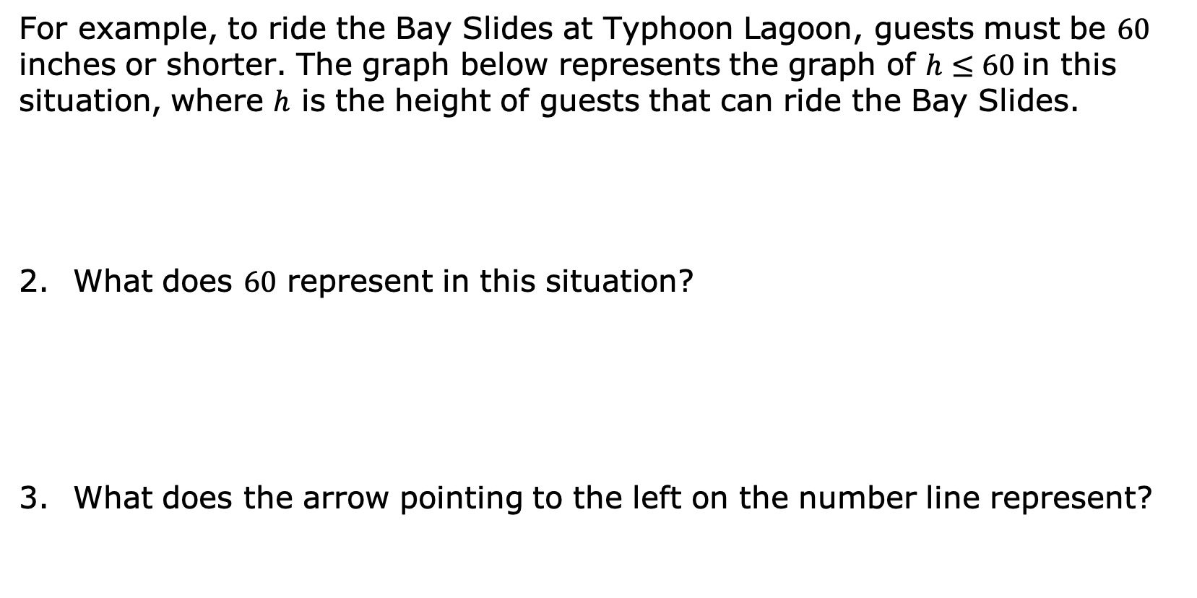
For example, to ride the Bay Slides at Typhoon Lagoon, guests must be $60$ inches or shorter. The graph below represents the graph of $h≤60$ in this situation, where $h$ is the height of guests that can ride the Bay Slides.
What does $60$ represent in this situation?
What does the arrow pointing to the left on the number line represent?
volume 2, pg. 386

Slide 18
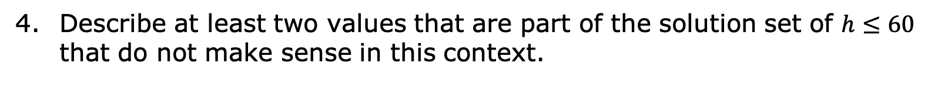
Describe at least two values that are part of the solution set of $h≤60$ that do not make sense in this context.
volume 2, pg. 386

Slide 19


Sometimes there are values that are part of the mathematical solution set that do not make sense in the context. In those cases, the variable may have a constraint (restriction or limitation) placed on it so that the mathematical model is realistic.
The Exploration demonstrated the inequalities $n−2≥48$ and $n≥50$ are equivalent because all of the same values of $n$ make both inequalities true. Both inequalities were also represented using the same graph.
Inequalities that have the same solution set are called equivalent inequalities.
volume 2, pg. 387

Slide 20
Exploration
volume 2, pg. 387

Slide 21
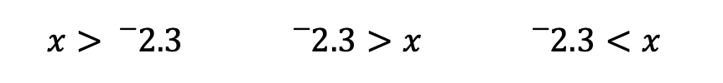
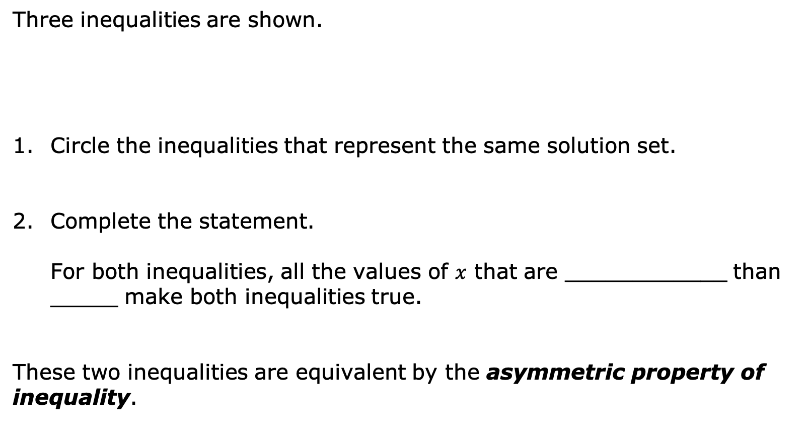
14.9.4 Exploration: Properties of Inequality
Three inequalities are shown.
Circle the inequalities that represent the same solution set.
Complete the statement.
For both inequalities, all the values of $x$ that are ____________ than _____ make both inequalities true.
These two inequalities are equivalent by the asymmetric property of inequality.
$$x>{}_{}^{−}{2.3}$$ | $${}_{}^{−}{2.3}>x$$ | $${}_{}^{−}{2.3}<x$$
volume 2, pg. 387

Slide 22

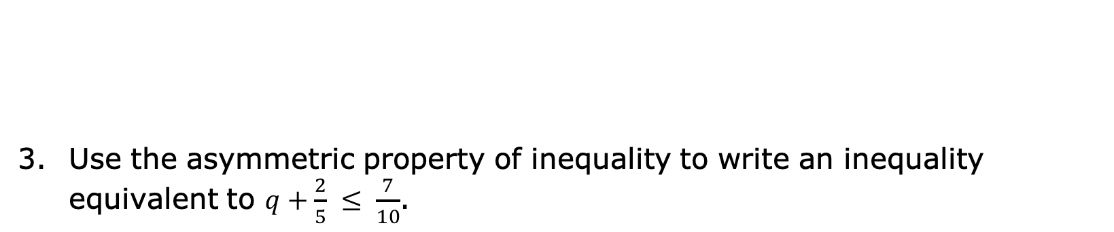
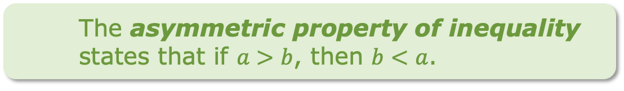
The asymmetric property of inequality states that if $a>b$, then $b<a$.
Use the asymmetric property of inequality to write an inequality equivalent to $q+\frac{2}{5} ≤ \frac{7}{10}$.
volume 2, pg. 387

Slide 23
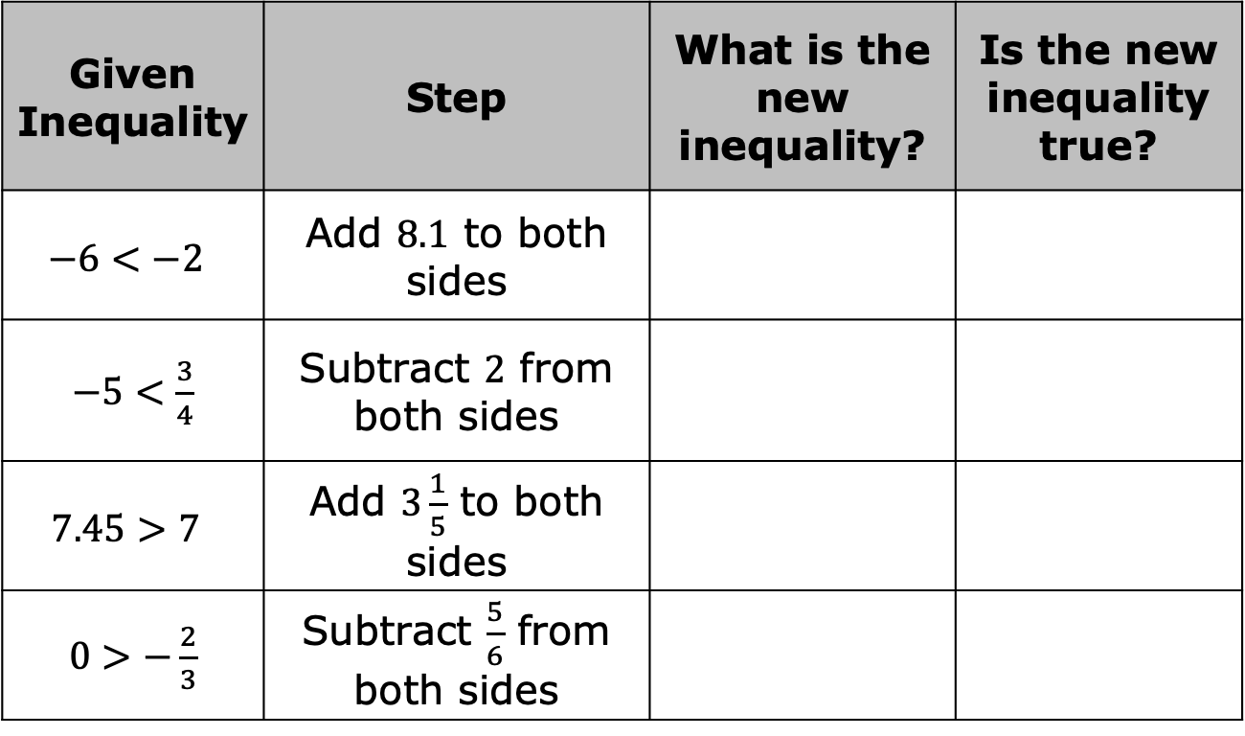
Four true inequalities are given in the table. Work with your partner to complete the table by following the steps indicated for each inequality and then answering the questions.
Given Inequality | Step | What is the new inequality? | Is the new inequality true?
$$−6<−2$$ | Add $8.1$ to both sides
$−5<\frac{3}{4}$ | Subtract $2$ from both sides
$$7.45>7$$ | Add $3\frac{1}{5}$ to both sides
$0>−\frac{2}{3}$ | Subtract $\frac{5}{6}$ from both sides
volume 2, pg. 388

Slide 24
Use your work on the previous problem to complete the description of each property.
Property of Inequality | Description
Addition property of inequality | When the same value is added to both sides of a true inequality, …
Subtraction property of inequality | When the same value is subtracted from both sides of a true inequality, …
volume 2, pg. 388

Slide 25

Guided Instruction
volume 2, pg. 388

Slide 26
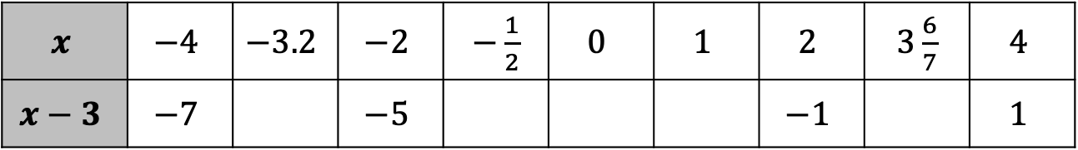
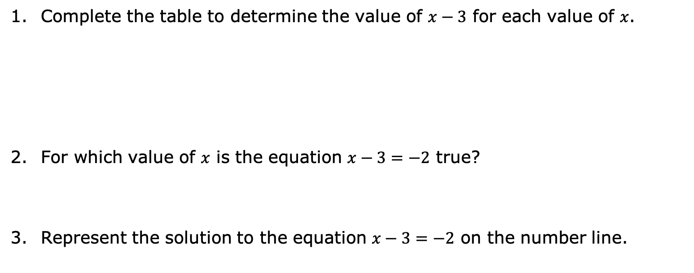
14.9.5 Guided Instruction: Solving One-Step Inequalities with Addition and Subtraction
Complete the table to determine the value of $x−3$ for each value of $x$.
For which value of $x$ is the equation $x−3=−2$ true?
Represent the solution to the equation $x−3=−2$ on the number line.
$$x$$ | $$−4$$ | $$−3.2$$ | $$−2$$ | $−\frac{1}{2}$ | $$0$$ | $$1$$ | $$2$$ | $3\frac{6}{7}$ | $$4$$
$$x−3$$ | $$−7$$ |  | $$−5$$ |  |  |  | $$−1$$ |  | $$1$$
volume 2, pg. 388

Slide 27
For which values of $x$ in the table is the inequality $x−3>−2$ true?
volume 2, pg. 388

Slide 28
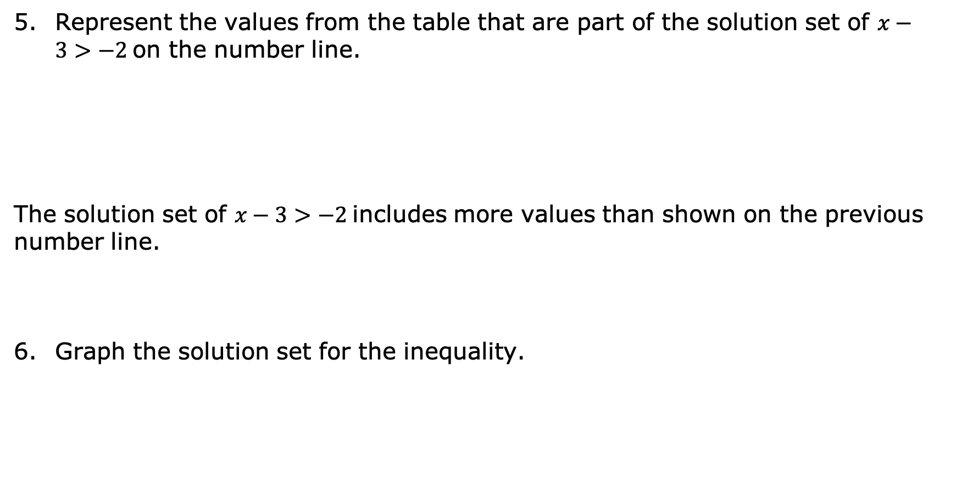
Represent the values from the table that are part of the solution set of $x−3>−2$ on the number line.
The solution set of $x−3>−2$ includes more values than shown on the previous number line.
Graph the solution set for the inequality.
volume 2, pg. 389

Slide 29

Write a value on the line to show an equivalent inequality represented by the graph above.
$$x > ______$$
The solution set of the inequality $x−3>−2$ is all the values of $x$ that are greater than $1$, or $x>1$.
volume 2, pg. 389

Slide 30
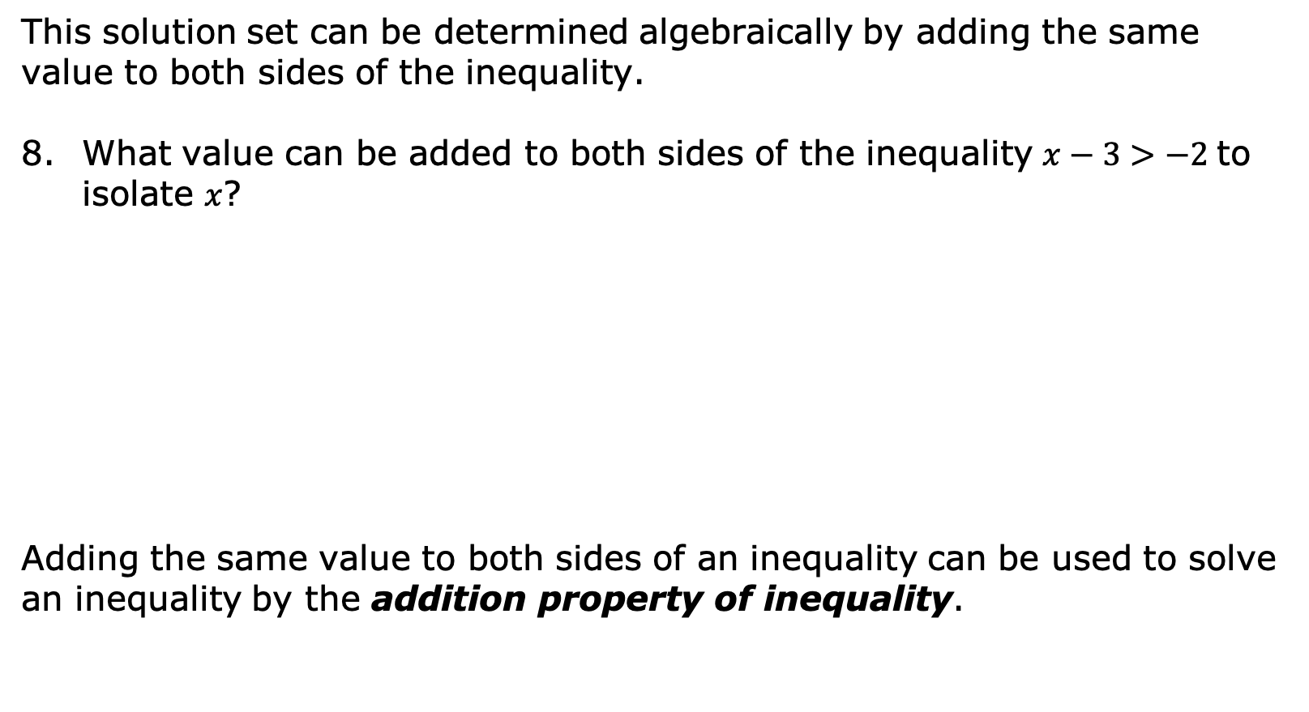
This solution set can be determined algebraically by adding the same value to both sides of the inequality.
What value can be added to both sides of the inequality $x−3>−2$ to isolate $x$?
Adding the same value to both sides of an inequality can be used to solve an inequality by the addition property of inequality.
volume 2, pg. 389

Slide 31

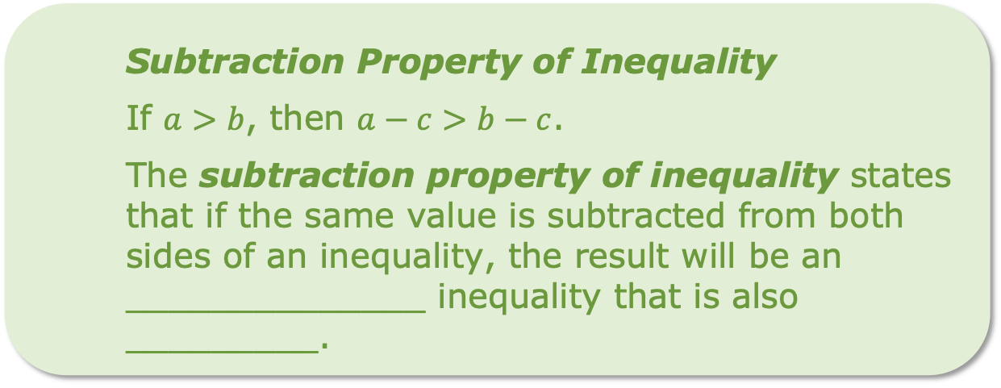
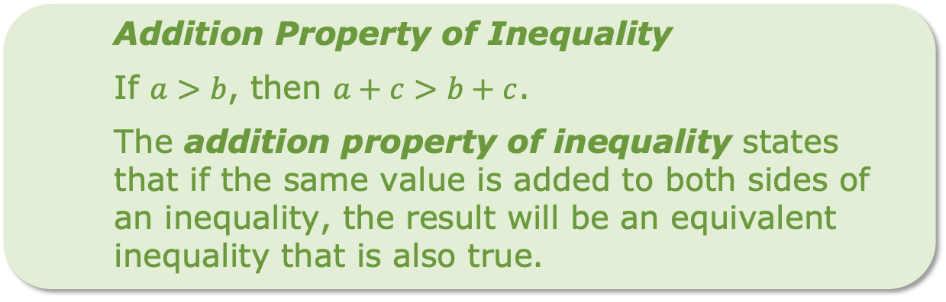
Addition Property of Inequality
If $a>b$, then $a+c>b+c$.
The addition property of inequality states that if the same value is added to both sides of an inequality, the result will be an equivalent inequality that is also true.
The subtraction property of inequality can also be used to solve an inequality.
Subtraction Property of Inequality
If $a>b$, then $a−c>b−c$.
The subtraction property of inequality states that if the same value is subtracted from both sides of an inequality, the result will be an ______________ inequality that is also _________.
volume 2, pg. 389

Slide 32
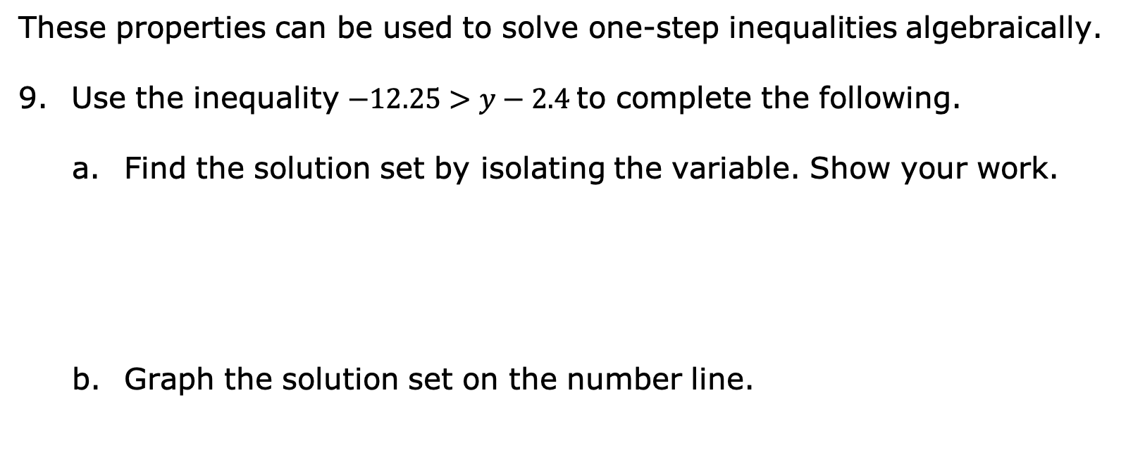
These properties can be used to solve one-step inequalities algebraically.
Use the inequality $−12.25>y−2.4$ to complete the following.
Find the solution set by isolating the variable. Show your work.
Graph the solution set on the number line.
volume 2, pg. 390

Slide 33
Use substitution to test a value or values in order to verify that the solution and the graph are correct.
volume 2, pg. 390

Slide 34

Wrap-Up
volume 2, pg. 390

Slide 35
14.9.6 Wrap-Up: Cool Down
Complete the table.
The terms and information used in today’s lesson that I knew were… | Something I wondered during today’s lesson was… | Something I learned during today’s lesson was…
volume 2, pg. 390

